Slide 1
SAP UI5 – Beginner Level

Slide 2
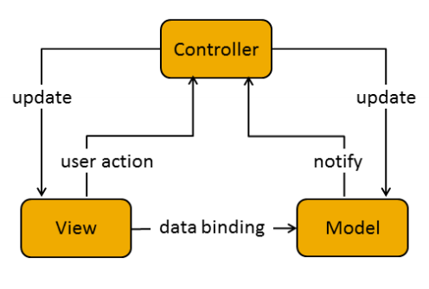
Model View Controller (MVC)
In the Model View Controller concept, the representation of information is separated from the user's interaction:
The view is responsible for defining and rendering the UI. (By placing all UI controls in view)
The model manages the application data.
The controller reacts to view events and user interaction by modifying the view and model. (Events, Navigation & UI Operations)

Slide 3
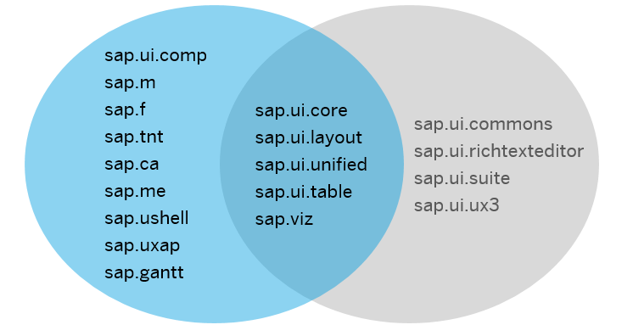
UI5 Libraries

Slide 4
Details Of Libraries
sap.ui.core : This library contains the jQuery plugins (jQuery.sap.*), the core and all its components, base classes for controls, components and the Model-View-Controller (MVC) classes.
sap.m : controls designed for mobile devices and tablets ,can also be used for desktop.
sap.ui.layout : contains all layout controls can be combined with other libraries
sap.ui.model : It is SAP UI5 Data binding API.
sap.ui.table : It contains all the table controls
sap.ui.view : Creates a view of the given type, name and with the given id.

Slide 5
Lifecycle Hooks of the View
onInit(): Called when a view is instantiated and its controls (if available) have already been created; used to modify the view before it is displayed to bind event handlers and do other one-time initialization
onExit(): Called when the view is destroyed; used to free resources and finalize activities
onAfterRendering(): Called when the view has been rendered and, therefore, its HTML is part of the document; used to do post-rendering manipulations of the HTML. SAPUI5 controls get this hook after being rendered.
onBeforeRendering(): Invoked before the controller view is re-rendered and not before the first rendering; use onInit() for invoking the hook before the first rendering

Slide 6
SAP UI5 Application Project Structure
<webapp_root_folder>
Application.js
css … all CSS files go here (and potentially related images)
style.css … and potentially more stylesheets
ext … all reused third party java script goes here
i18n … all property files for localization go here
i18n.properties
i18n_de.properties
i18n_en.properties
…
model
util .. all helper classes go here
view .. all view files go here; all file names shall start with an upper case letter
Controller all the controller files go here.
img … all image files go here (png, jpg, gif, …)
<someNamespace> all on-the-fly controls defined within the application go here
<controlName>.js
index.html

Slide 7
Resource Handling
In SAPUI5, resources are handled in a client-side and a server-side part.
Client-side Resource Handling
Modularization of JavaScript files
Localization of application texts with resource bundles
Server-side Resource Handling
For the Java server and the integration into Eclipse, SAPUI5 provides a resource handler to improve the interaction between client and server.It is also used to support modularized development of SAPUI5 applications and libraries.

Slide 8
SAPUI5 Components
Components are independent and reusable parts used in SAPUI5 applications.
SAPUI5 provides the following two types of components:
Faceless components (class: sap.ui.core.Component)
Faceless components do not have a user interface and are used, for example, for a service that delivers data from a back-end system.
UI components (class: sap.ui.core.UIComponent)

Slide 9
Structure of a component
A component is a folder. The folder name defines the component name and contains all optional and required resources.
component.js
This is the component controller and provides the runtime metadata (properties, aggregation, events) and the component methods. The name parameter that is passed to the component constructor represents the package name under which you can find the component.
component.json
This is the component descriptor and contains the design-time metadata. The file is not loaded during runtime. The file is currently not used, but may be used in the future for design-time tools.

Slide 10
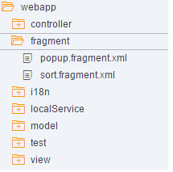
Fragments
Fragments is a technique used to split the codes into different files which will be dynamically called into a specified area in a UI5 page to get the final Output.
Fragments files are created with the extension <fragmentname>.fragment.xml.

Slide 11
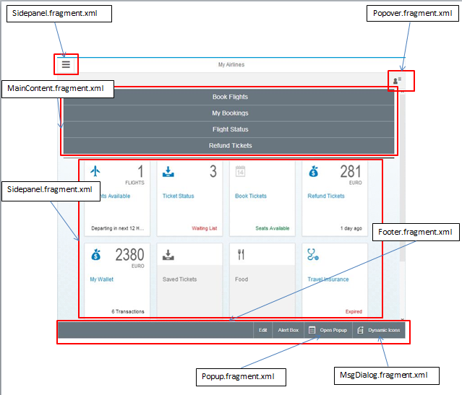

Fragment example
Fragments are called dynamically in the parent view by using the syntax as shown in the above screenshot

Slide 12
Types of views
XML Views
Javascript View
JSON View
HTML View
Types of models
OData Model
JSON Model
XML Model
Resource Model

Slide 13
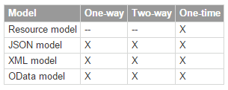
Types of Bindings
Property Binding
Aggregation Binding
Element Binding

Slide 14
Models and Data Binding
Data binding is used to bind two data sources or information sources together and to keep them in synch.
Model instances hold the data and provide the methods required to set the data or to retrieve data from a server.
Types Of Bindings are
Property Binding
Aggregation Binding
Element Binding

Slide 15
Property Binding
To define a property binding on a control, the following two options exist:
In the settings object in the constructor of a control
var oTextField = new sap.m.TextField(
{
value: "{/company/name}“
});
Using the bindProperty method of a control
oTextField.bindProperty("value", "/company/name");

Slide 16
Aggregation Binding
You can define aggregation binding either in the settings object in the constructor or by calling the bindAggregation method.
Binding through Settings object
var oItemTemplate = new sap.ui.core.ListItem(
{
text:"{name}“
});
var oComboBox = new sap.m.ComboBox(
{
items: { path: "/company/contacts", template: oItemTemplate }
});
Binding through bindAggregation method
oComboBox.bindAggregation("items", "/company/contacts", new sap.ui.core.ListItem(
{
text:"{name}“
}));

Slide 17
Element Binding
Binding an element allows to set the binding context of the element to the object referenced by the given binding path.
To define an element binding, use the bindElement method on a control:
var oLayout = new sap.ui.layout.VerticalLayout();
oLayout.bindElement("/company");
oLayout.addContent(
new sap.m.Label({text: "Name:"}),
new sap.m.TextField({value: "{name}"})
);

Slide 18
Useful links
SAP UI5 Demo kit- https://sapui5.hana.ondemand.com/sdk/#content/Controls/index.html
SCN Community page- http://scn.sap.com/community/developer-center/front-end
SAP UI5 testsuite- https://sapui5.hana.ondemand.com/sdk/test-resources/testsuite/testframe.html
Creating SAP UI5 Project http://scn.sap.com/docs/DOC-37805

Slide 19

Questions???

Slide 20


